Slide 1
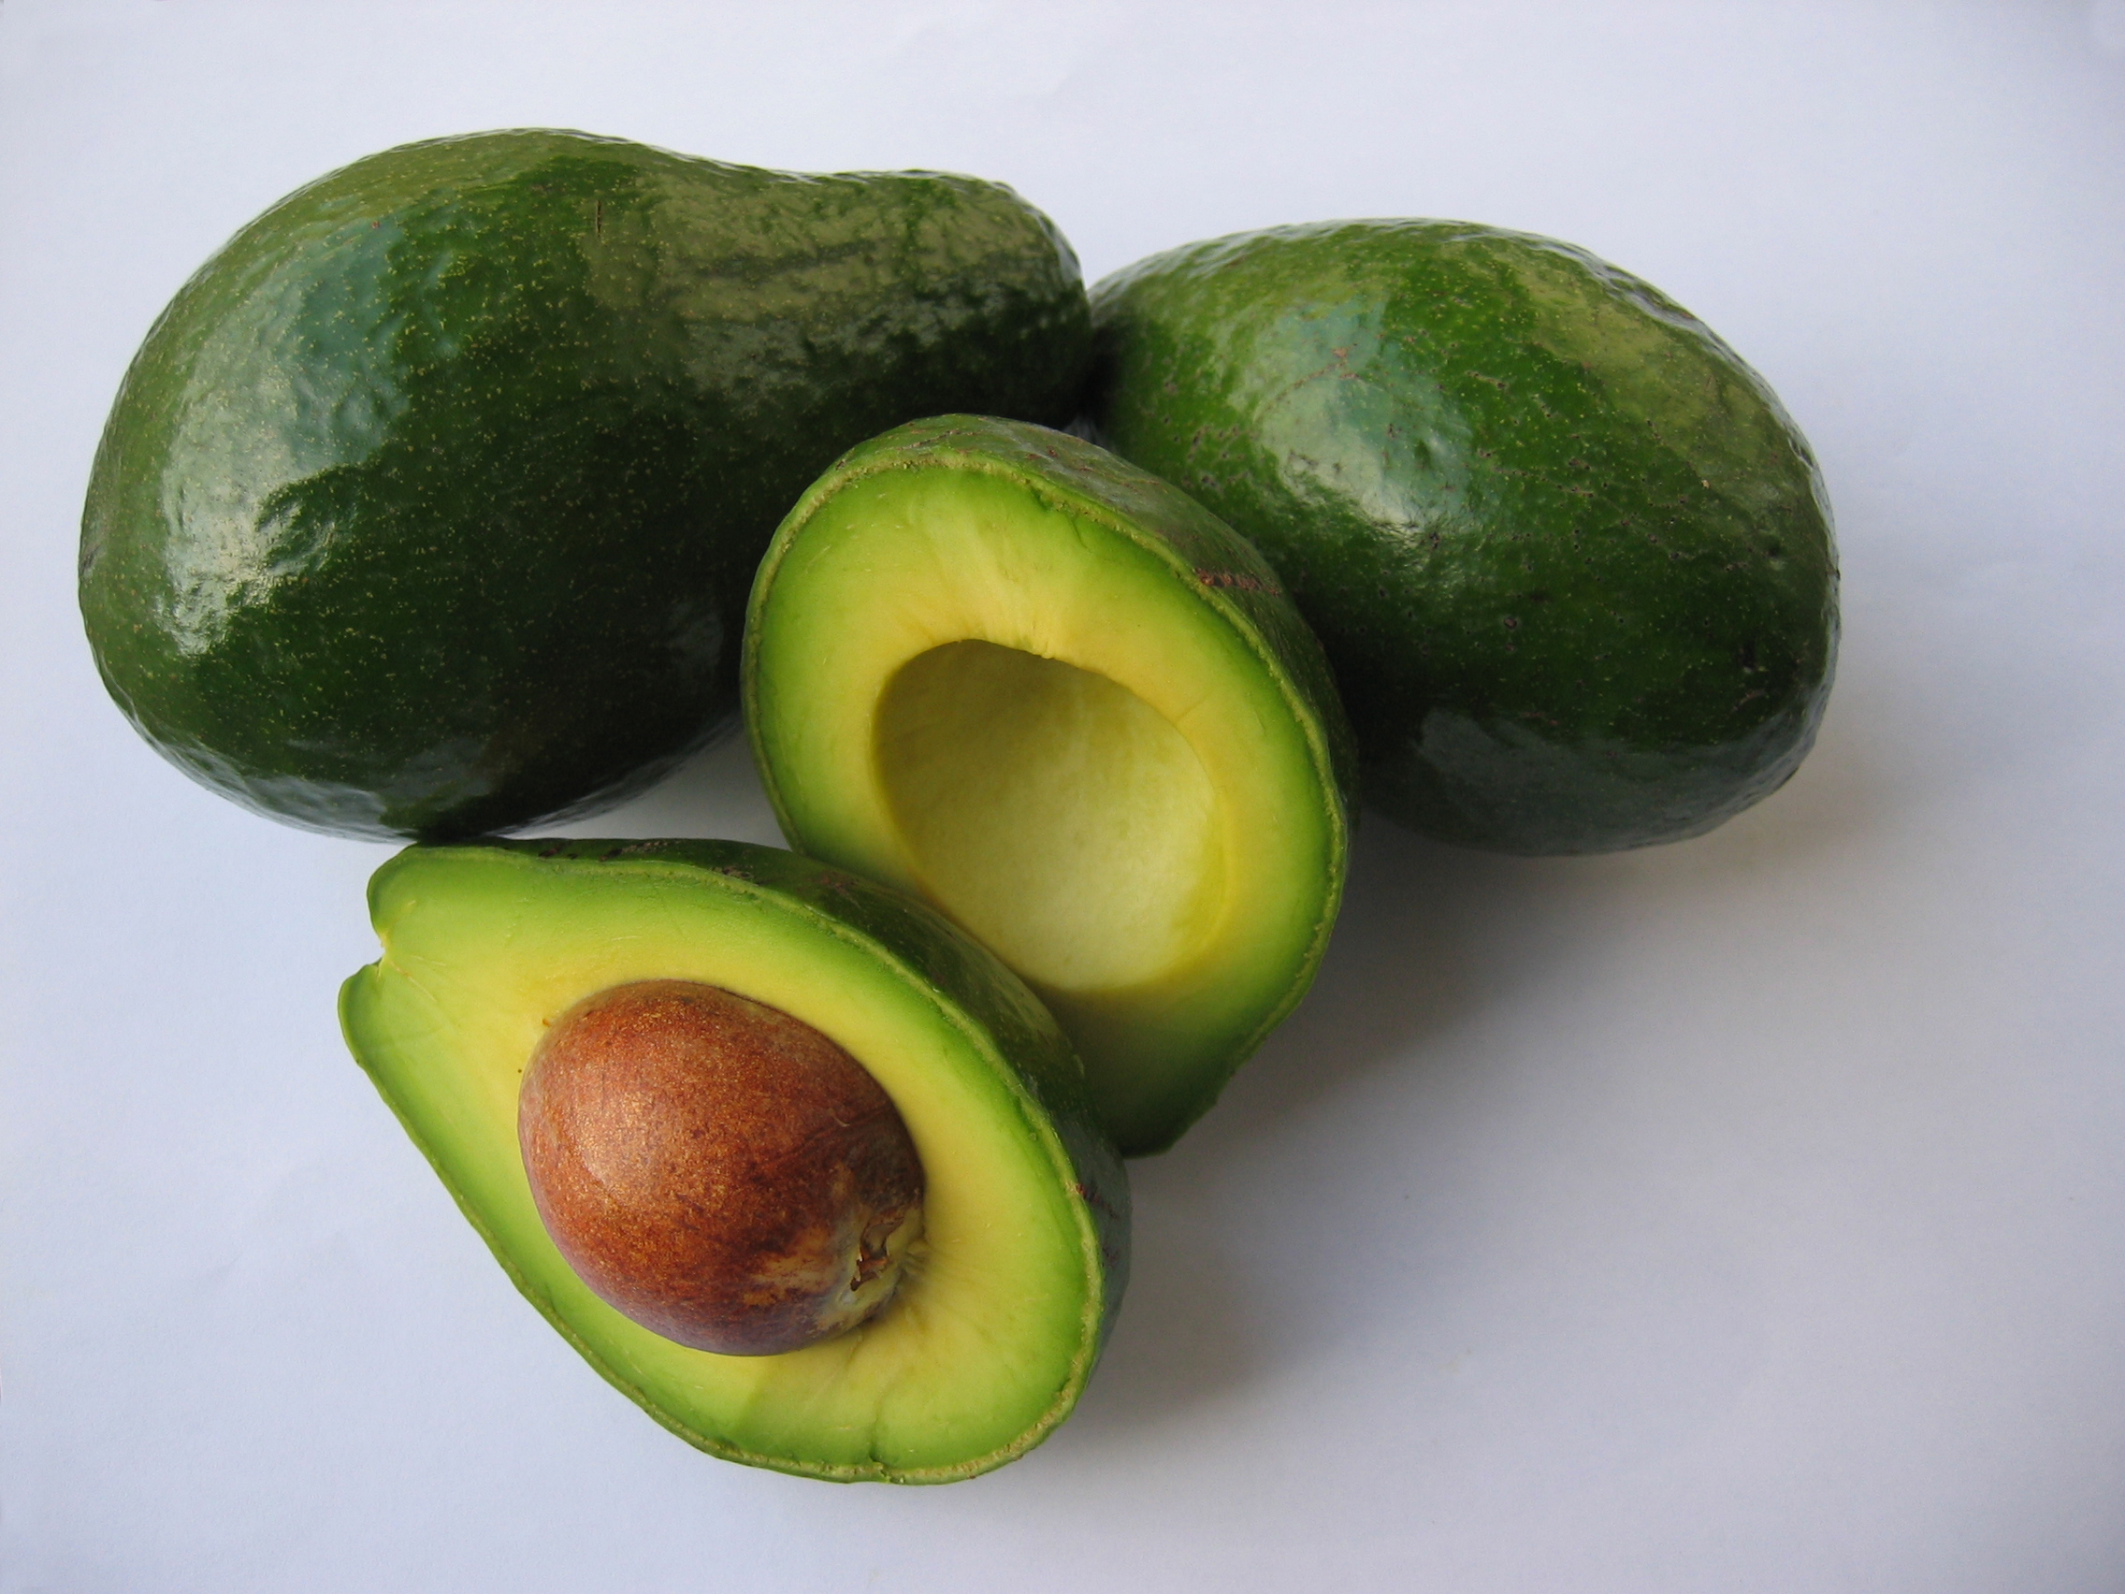
Avocado Price Analysis
Presented by: Skylur Zimmerman
Last Updated: January 29, 2024

Slide 2
Objectives
In which regions are avocados the least and most expensive?
Which year was the least and most expensive for avocado prices?

Slide 3
Conventional Avocado Prices per Region
Notes:
On average casual customers have longer ride lengths.

Slide 4
Organic Avocado Prices per Region
Notes:
On average casual customers have longer ride lengths.

Slide 5
Avocado Prices per Year
Notes:
On average casual customers have longer ride lengths.

Slide 6
Conclusions
Conventional Avocados
Organic Avocados
PhoenixTucson is the least expensive
HartfordSpringfield is the most expensive
2015 is the lowest year
2017 is the highest year
Houston is the least expensive
HartfordSpringfield is the most expensive
2016 & 2018 ties for the lowest year
2017 is the highest year
You would have to really love guacamole to buy avocados in HartfordSpringfield region during 2017

